Slide 1
PHP Frameworks and analysis in Nepal
Personal detail
Name: Sinuna Chaudhary
IT Graduate (Computing), Islington College
Media & Marketing Manager, Girls in Technology
Web Developer, Softech Foundation

Slide 2
Topics
PHP Framework
Benefits
Best PHP Framework for 2015
Most exciting open source software
Think for some security concern
Demand of PHP in Nepal
References

Slide 3
PHP Framework
PHP is a powerful scripting language used to create dynamic website.
A PHP framework is just an extension of PHP that someone has built.
We can create our own system using a framework.

Slide 4
Benefits
Clean urls ( SEO friendly urls )
Coding standard, Security
MVC Pattern
Reuse of code
Flexible
Community Support
Job Opportunity
Suitable for Teamwork, and its fun!

Slide 5
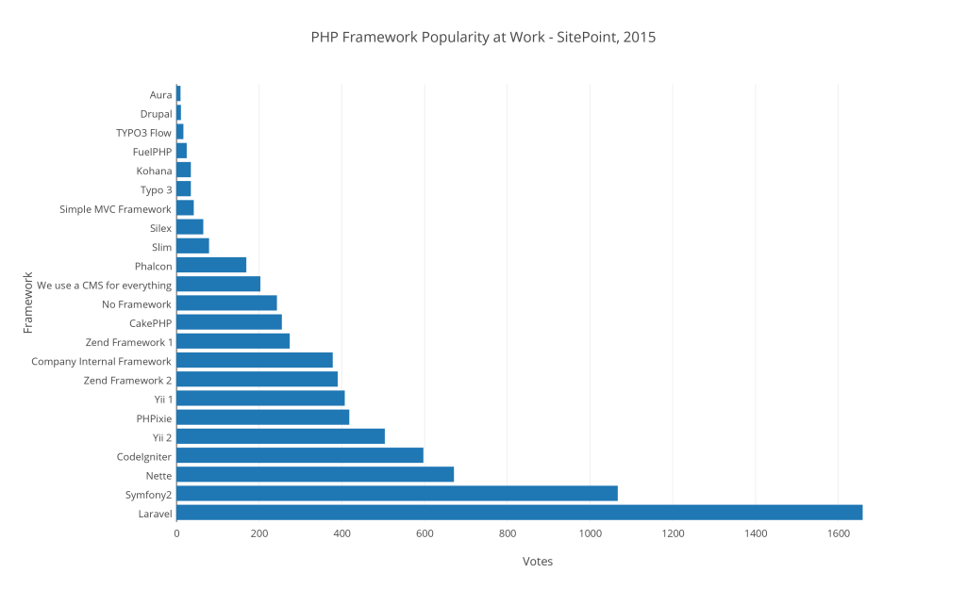
Best PHP Framework for 2015 As you can see in following plot, Laravel has won the best php framework in 2015.

Slide 6
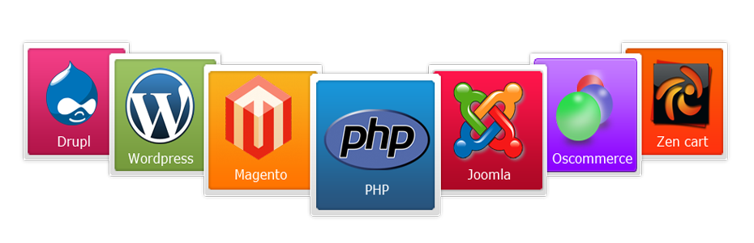
Most exciting PHP open source software
Readymade CMS

Slide 7

Think for some security concern
Post method instead of Get method
Prevent SQL injection
Server side validation and form validation issue
XSS clean data-Data sanitize
Trusted source code, trusted plugin and libraries
Password (Special characters)
Add Secret Key to URLs
Eg: use www.site.com/secretkey
Instead of /admin

Slide 8
Demand of PHP in Nepal
There is very high demand of PHP developers in software companies of Nepal. As we can see many vacancy of PHP developers in job portal comparing to others.
Code igniter is popular and mostly used framework in Nepal. Likewise Word press, Joomla are the popular CMS in Nepal.
PHP developers are highly demanded in nationally and internationally.

Slide 9
Reference
http://www.sitepoint.com/best-php-framework-2015-sitepoint-survey-results/
http://html.net/

Slide 10
Follow Us:
www.facebook.com/girlsintechnology
info@gitechnology.org
https://twitter.com/sinunachaudhary
sinuna@gitechnology.org

Slide 11
Thank you...

